Slide 1
Where do I Start ??
Cannot just walk in a start up network scanners.
Gain as must information as you can about the area under review.
Understand what the requirements of review / audit are.

Slide 2
Obtain Information
Google / Bing – a wealth of information
Meeting with the clients
Understand their expectations and requirements
Client or Company Documentation such as network diagrams, policies and procedures manuals.
Prior Audit Reports

Slide 3
Engagement Letter Memo of Understanding
Must be issued and signed by the client or auditee before any work is done.
Prevents misunderstanding.
Sets Expectations by all parties.
Is a legal document in case the engagement heads South !!
Document !!!!!!!!!!!!

Slide 4
Scoping
Defines the area’s that are covered by the review.
Must be specific as possible.
Example
Bad – We will test the ULM Network
Better – We will test ULM’s Wireless Network segment.
Best – We will test the Financial network Segments with emphasis on the production servers

Slide 5
Examples from Actual Engagements
“ In our proposal to serve CBC , the scope of our services and deliverables will include the following areas which are mandated by Federal Financial Institutions Examination Council (FFIEC) audit examination guidelines:
Information Security
Change Control
Disaster Recovery and Business Continuity Planning
Networking – Internal – XYZ production network
Backup and Recovery
Computer Operations
Vendor Management “

Slide 6
Rules of Engagement
Specify what you can do and not do.
Try to be Specific as must as possible.
For testing specify a time frame of tests.
Lets take a look at a example:

Slide 7
Example of Rules of Engagement
No testing outside of what is defined within Engagement Letter and the following IP Addresses without authorization from XYZ.
169.254.99.1
169.254.99.254
Since this is a limited time testing we will concentrate on firewall and systems in the DMZ Zone.
Testing will be performed from 7 pm to 12 am.
The website hosted by Sun Trust is outside the scope of this test.
No Denial of service attack on network unless otherwise stated.
All testing will be “noisy” testing no stealth testing will be performed.
No port or vulnerability scanning outside of approved/provided list above without authorization.
No turn off/on services on production servers/systems without authorization.

Slide 8
Approach
How are your doing to do the review ??
A Narrative description of how your doing to do the task. The Shorter the Better.
Descript the use of any tools

Slide 9
Approach Example
The approach consists of planning/preparation, fieldwork and reporting. A critical component of the planning phase is to determine detailed audit objectives.
Once audit objectives are established, an audit program is developed. Control Solutions has established a shared site for storage of proven audit programs. In addition, Control Solutions auditors have access to regulatory sites (such as FFIEC, ISACA and IIA) to assist in developing customized audit programs.
Evidence request lists are prepared and sent to the business units prior to the commencement of the audit. IT audits are usually accomplished via inquiries of appropriate personnel, observation and detail testing of documentation and activities as appropriate

Slide 10
Approach Examples
Based on Control Solutions experience with Internet Security Testing, our Vulnerability and Penetration Testing methodology can be divided into four phases with an option for a Fifth Phase.
Phase I - Footprint Analysis and Information Gathering
Phase II - Confirmation of Vulnerability Scan
Phase III - Vulnerability Scanning
Phase IV - Penetration Test
Phase V - Ongoing Scanning

Slide 11
Assumes and Constraints
This is a catch all area that is used to protect your self.
Examples
Hours may be increased if the required documents are not received.
Limitations on the type of testing
Travel expenses are limited to 10% of the overall costs

Slide 12
Actual Engagement Example
Our assumptions and constraints for assembling our estimate of hours and the Hours/Cost breakdown that appears in Section 6, Professional Fees, include:
Assumption 1 – Key client personnel will be made available as required to ensure that relevant information is developed in a timely manner and requested information, artifacts, etc. also will be provided by client personnel in a timely fashion.
Assumption 2 – The number of walkthroughs directly relate to the number of business functional areas and IT technical areas that are determined to be in scope.
Assumption 3 – B Management Reviews will be completed quickly so as not to delay downstream activities.

Slide 13
Examples
The following items should be noted before a Company engages XYZ to perform a Penetration Test:
A Penetration Test tests the network at a given point in time. Subsequent changes to the systems or networks--such as new application systems, configuration, equipment etc.--may introduce new vulnerabilities to the network which were not identified or tested by Controls Solutions.
There is no guarantee that Control Solutions will obtain access to the internal network. Given enough time and funds, a person or organization can eventually gain access

Slide 14
Budgeting
How long is it going to take you ??
Give a detailed budget breakdown by task and person and/or staffing Level.

Slide 15
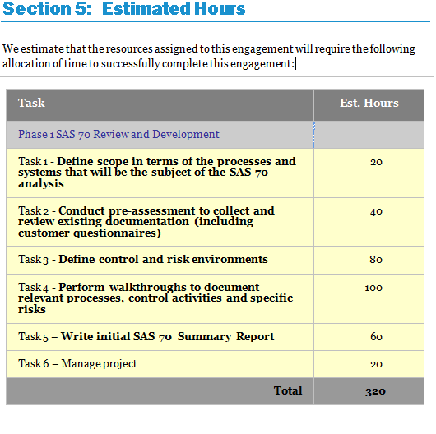
Estimated Hours

Slide 16
Deliverables
What are you going to give the client/auditee at the end of the engagement.
Typically a report with finding and observations. More on this Later.

Slide 17
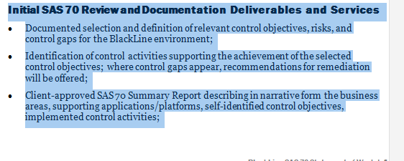
Deliverables

Slide 18
One More Document before you start

Slide 19
Rules of Engagement
Any servers/IP addresses not listed above are off limits. XYZ authorization is required.
Require special permission/authorization to test outside of the listed IP addresses.
High Risk/Critical findings reported upon discovery / vetting via client contract
Off hours testing will be reviewed and approved by client.
No Testing will be done during business hours are from 8am- 7 pm, Monday to Friday unless agreed to in writing.
Define/approve report format(s) in advance
Present preliminary results upon completion of task
All communication between parties will be done via secure, encrypted means,

Slide 20
Example
OIG Testing Agreement
The Office of Inspector General (OIG) for the House of Representatives agrees to hold harmless Altran Control Solutions and the ARC Group – referred to as the Consultants for any potential network, work station or server issues such as outages that may occur during the scans of selected workstation and servers.
OIG understands that scans for P2P software may result in disruptions of and/or damage to OIG or third party’s information systems and the information and data contained therein, including but not limited to denial of access to a legitimate system user, automatic shut-down of information systems caused by intrusion detection software or hardware, or failure of the information system.
The consultants will take all necessary precautions to prevent any potential problems prior to the actual scans. However during the course of the scans situations may arise which are outside of the control of the consultants that may cause network, workstations, or server disruptions.
As part of our engagement management process, we will monitor our adherence to the specific Rules of Engagement that will be issued by OIG agreed to by the auditee’s prior to the start of the scans.
Signed
______________________________________

Slide 21
Recap
Engagement Letter or SOW
Agreement on the Scope
Rules of Engagement
Deliverables

